Slide 1


Slide 2
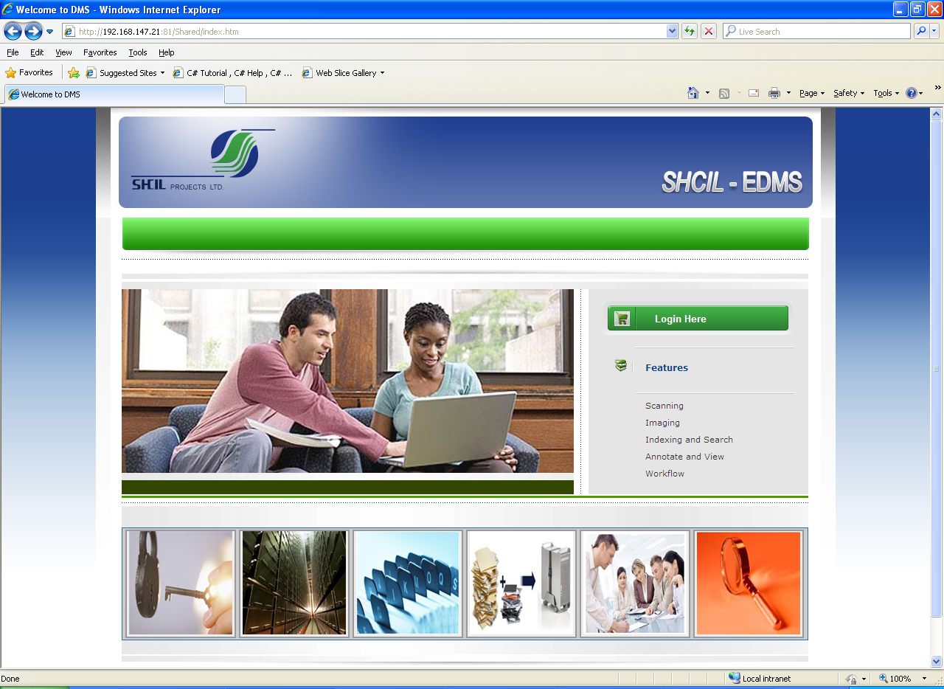
Index Page

Slide 3
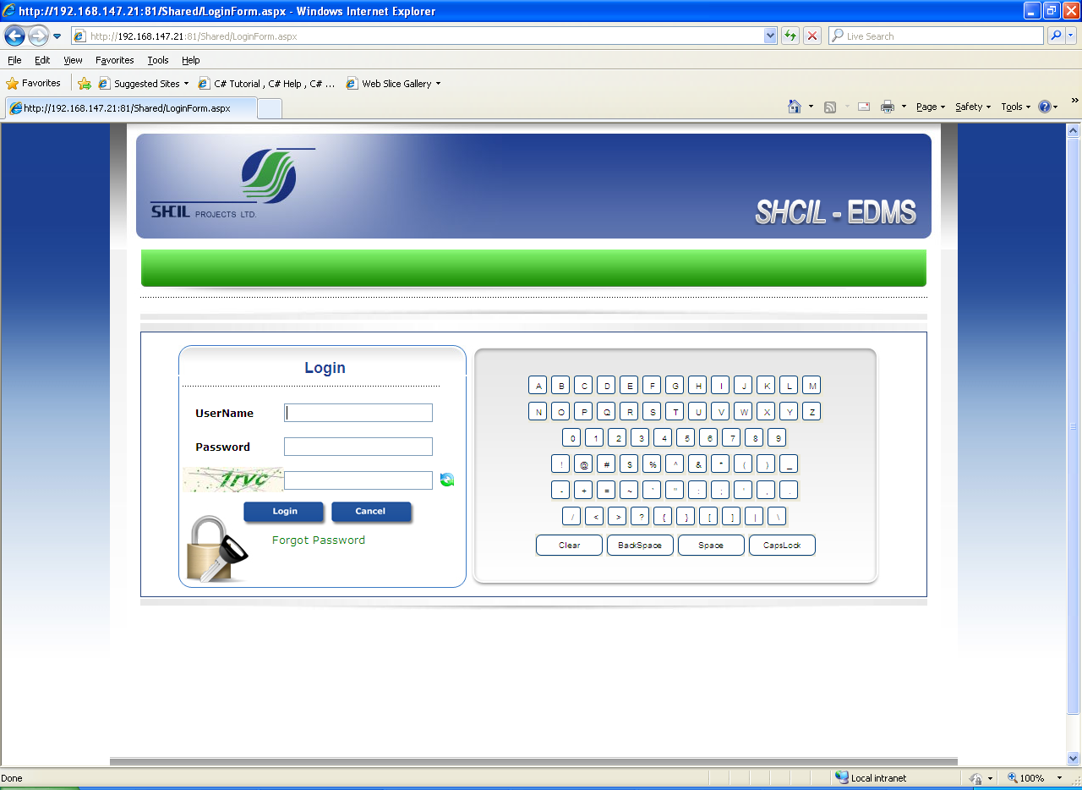
Login Page
In this page, we have to enter the user name and password. Once we enter the correct user name and password, we have to click on the submit button. However in any case we don’t want to login, we have to simply click on the cancel button.

Slide 4
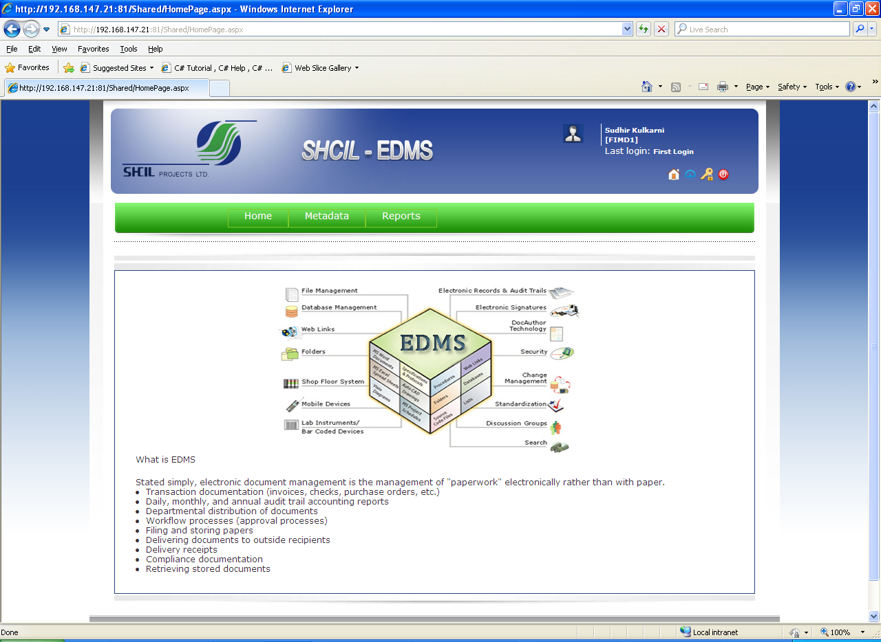
Home Page
This is the post login page. On this page there is menu bar. Menu bar is on the top of the page. In the menu bar describe the Administration, Module, Metadata and Reports, and folder/subfolder and the related files and folder information regarding selected folder.

Slide 5
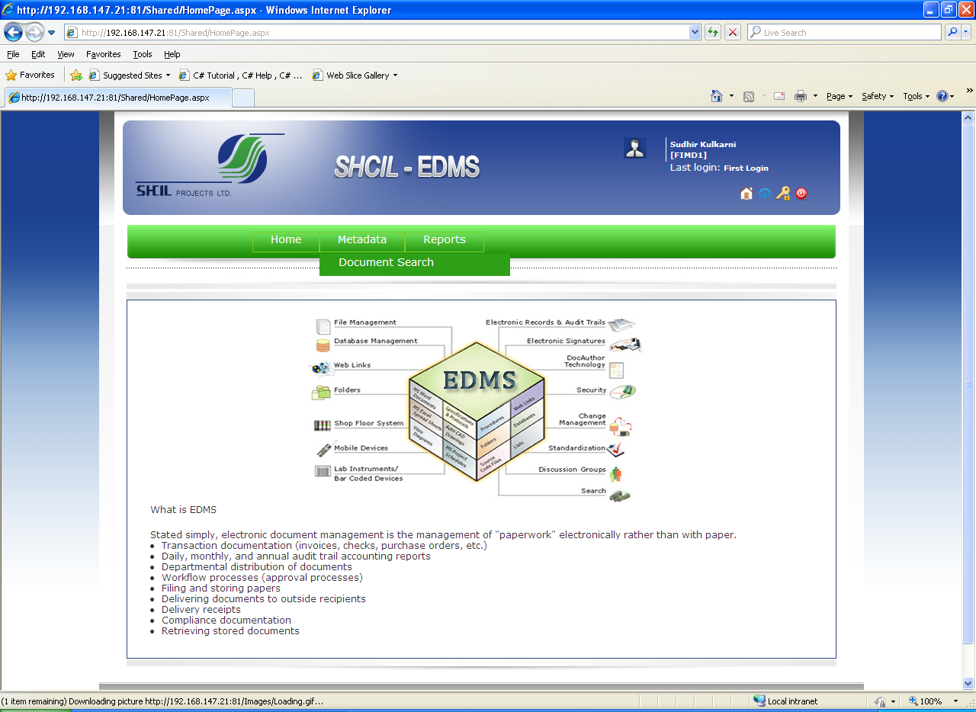
Document Search

Slide 6
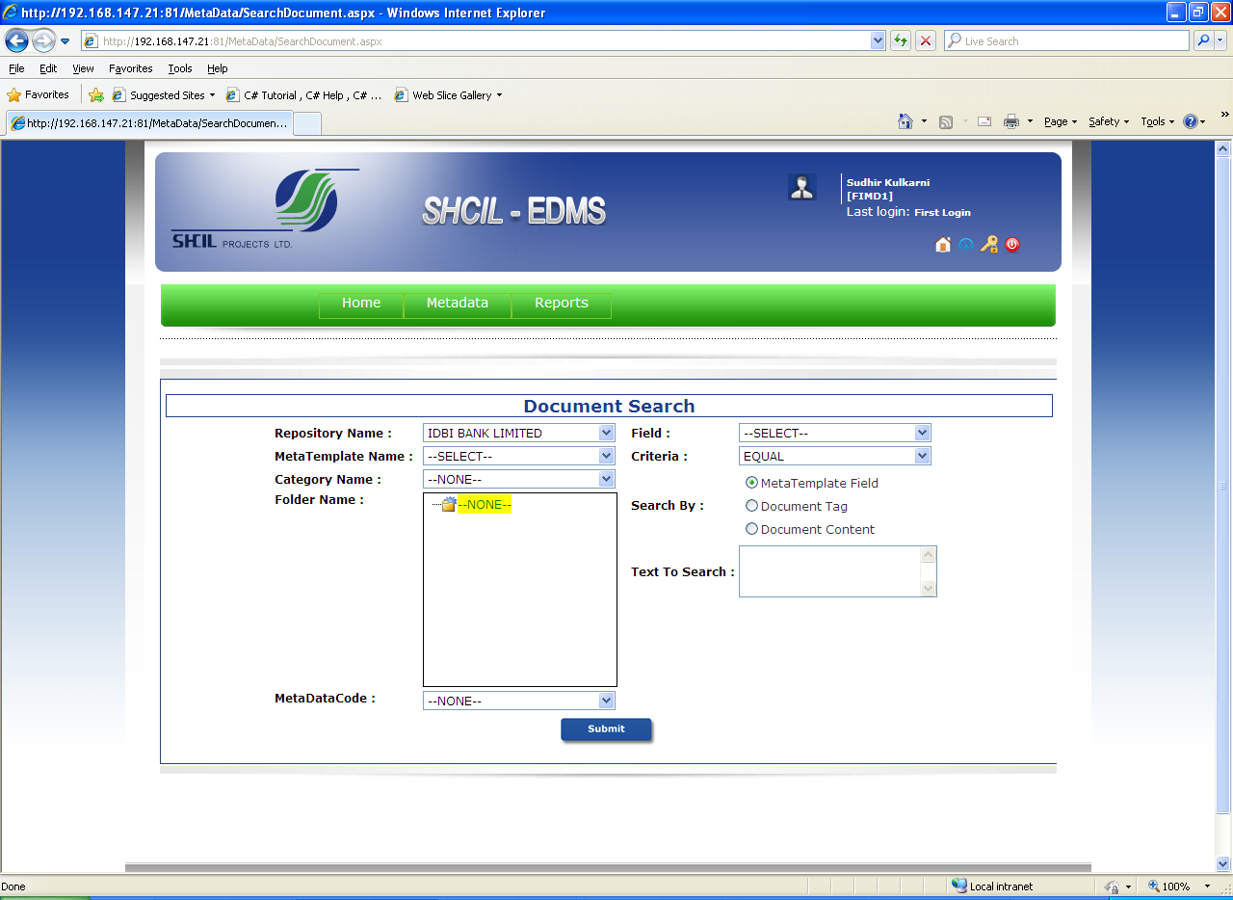
In the document search select the Repository name and then select the meta template name and category name, folder name are optional, meta data code helps to search in a particular folder of a meta data ,select the field type and category to search ,search by and text to search are optional.

Slide 7
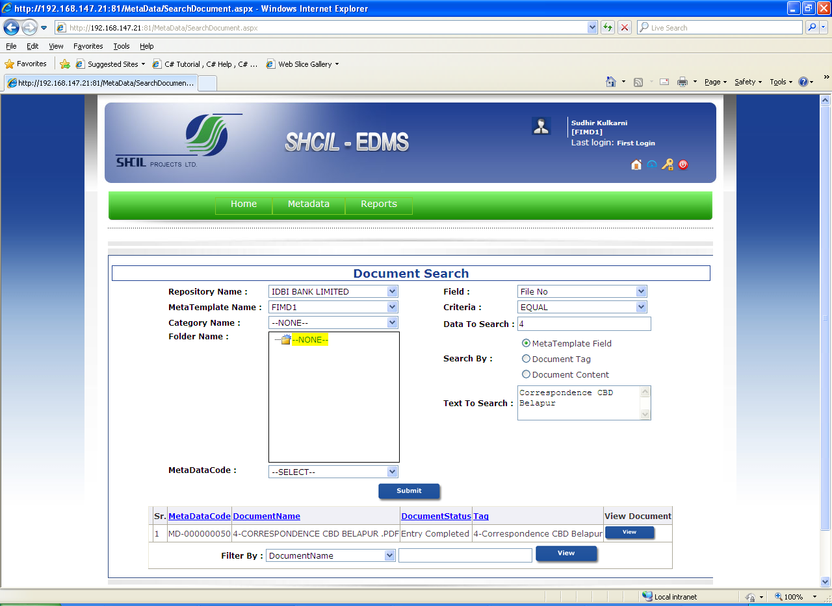
MetaTemplate Field Search
In the document search select the Repository name is selected then meta template name, Field, Criteria helps to search more efficiently. Select the ‘metadata code’ to search. ‘Search by’ and ‘text to search’ are optional.

Slide 8
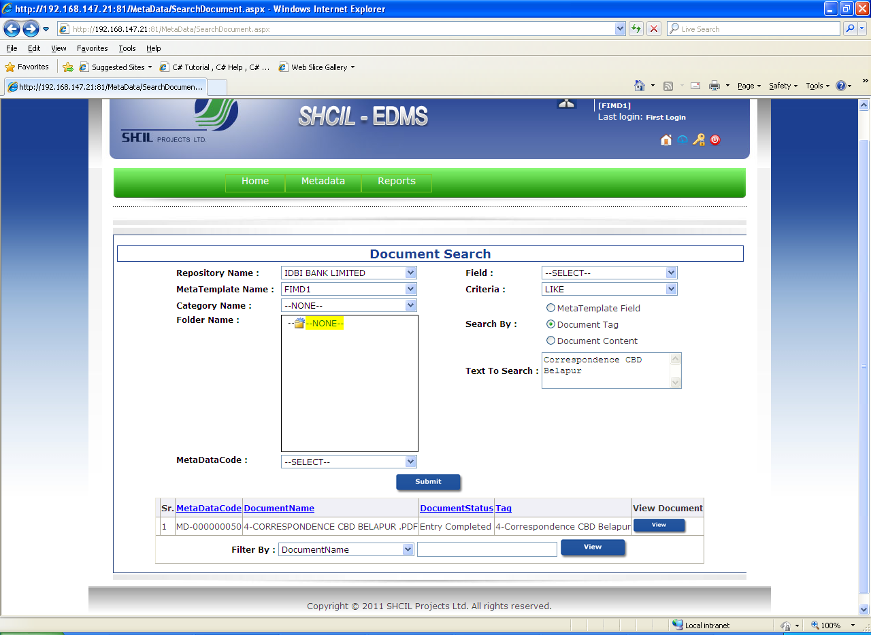
Document Tag Search
Select Document Tag on radio button and enter document tag name to be search.

Slide 9
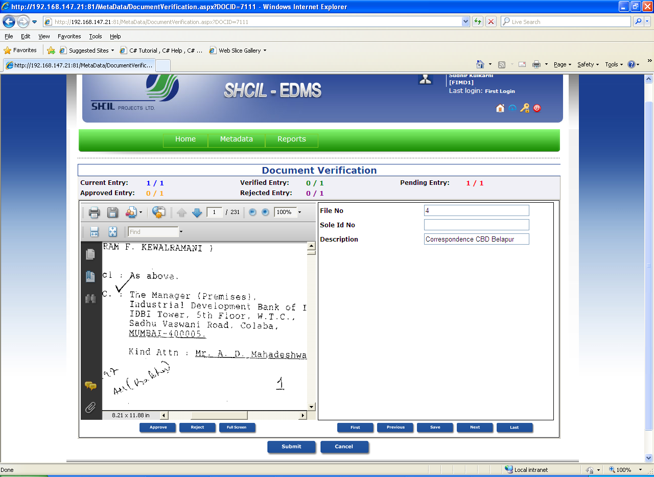
After selecting the mandatory fields like repository name ,Meta template name , field ,criteria ,data to search then click on submit ,then the following fields are displayed meta data code, File No., Sole Id No., Description. Then click on view then the document which is uploaded in that metadata code is displayed .

Slide 10
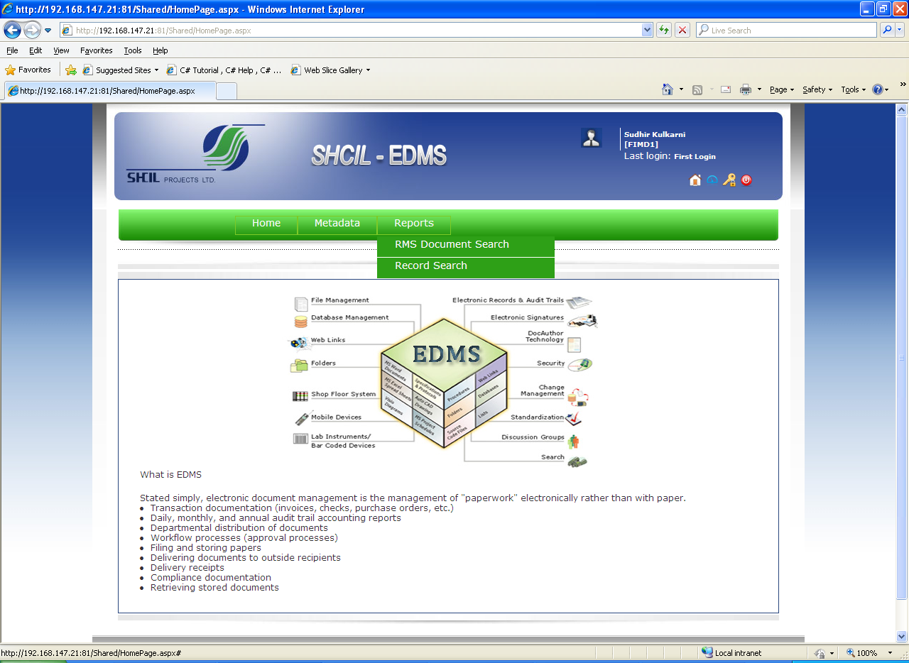
Record Search

Slide 11
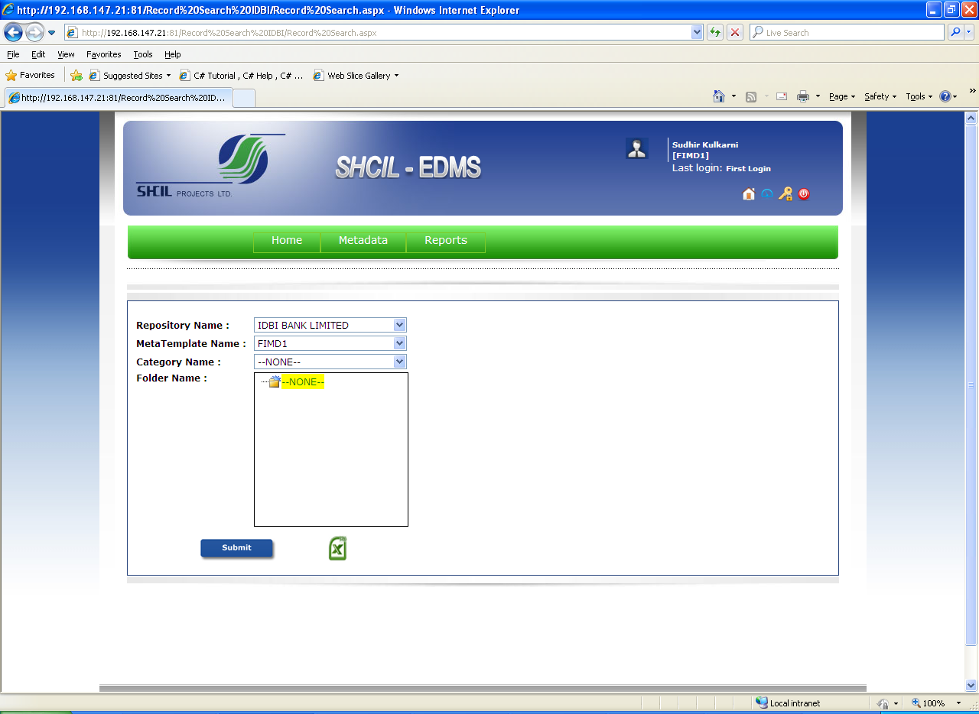
In the record search select the Repository name in which u want to search and then select the meta template name then click on submit button for required search.

Slide 12
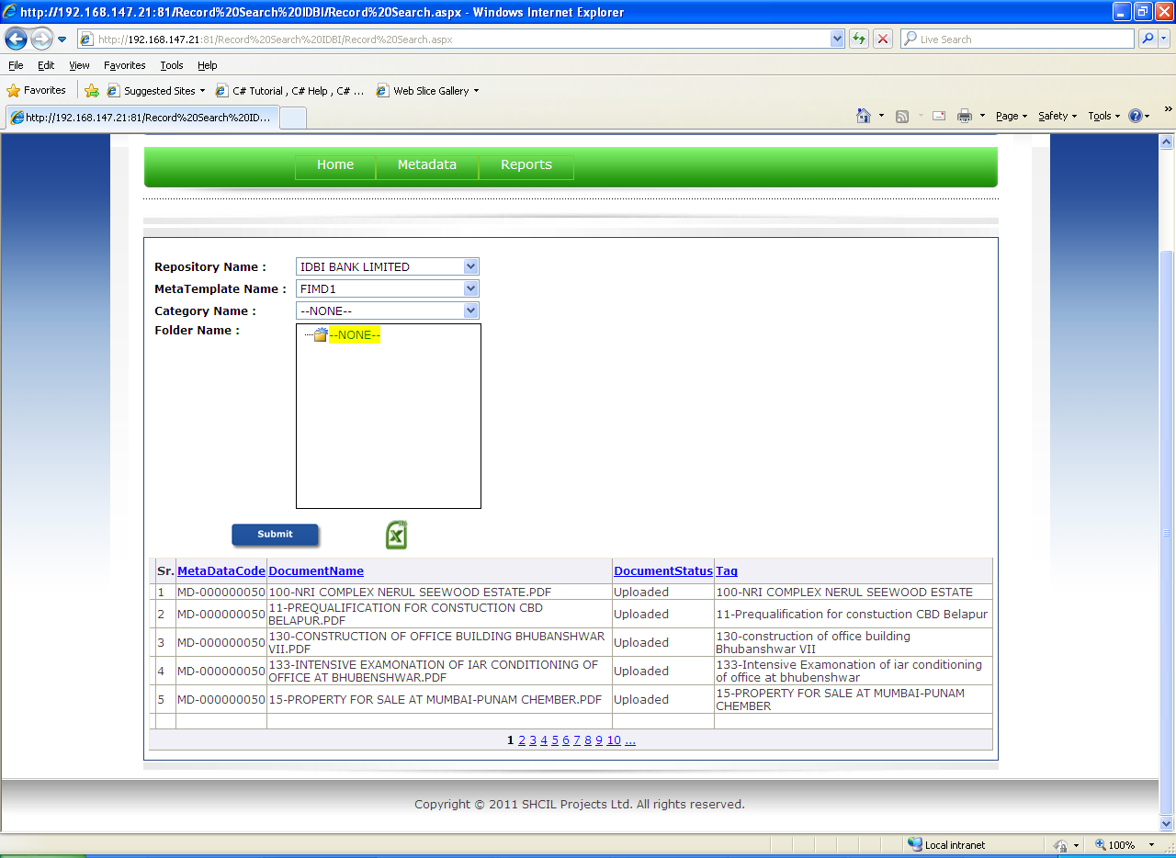
All Records are Display on Screen

Slide 13

RMS Document Search

Slide 14
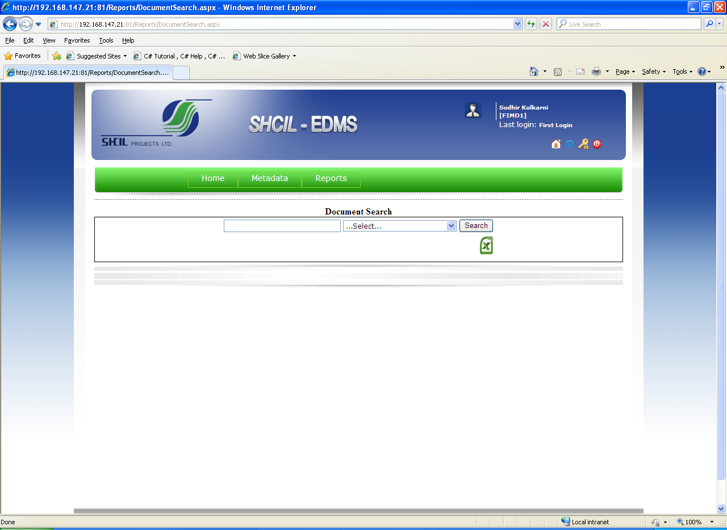
For RMS Document search select we can search the document by Sole Id No., file No., Description or All documents can also be searched with all option.

Slide 15
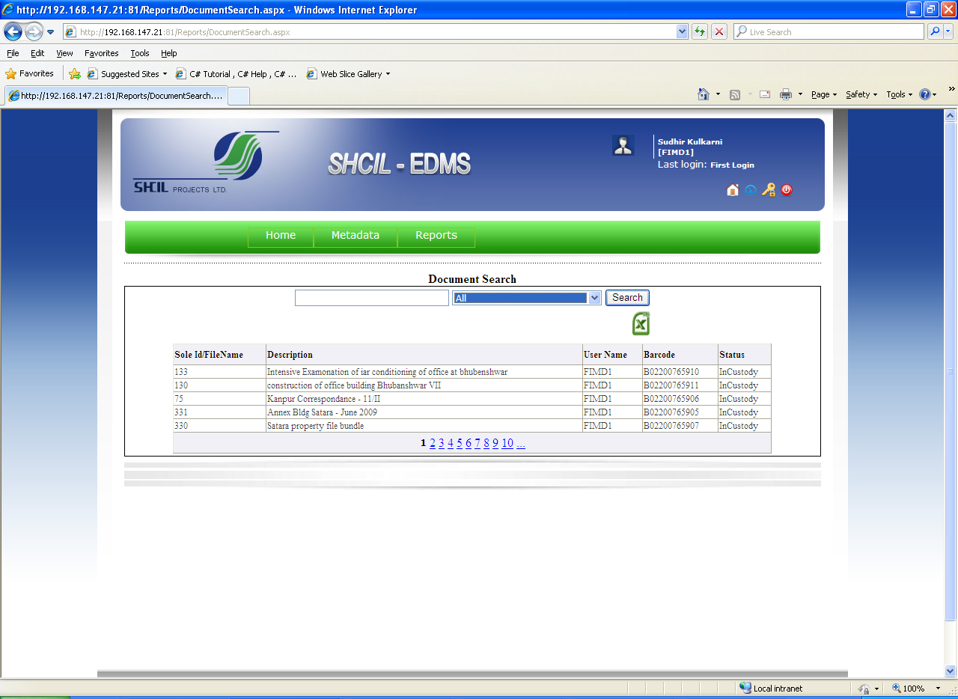
RMS Record Search page is Displayed on the Screen.

Slide 16
Thank You…!!!

